Slide 1
The line of best fit (regression line)
Coefficient of correlation

Slide 2
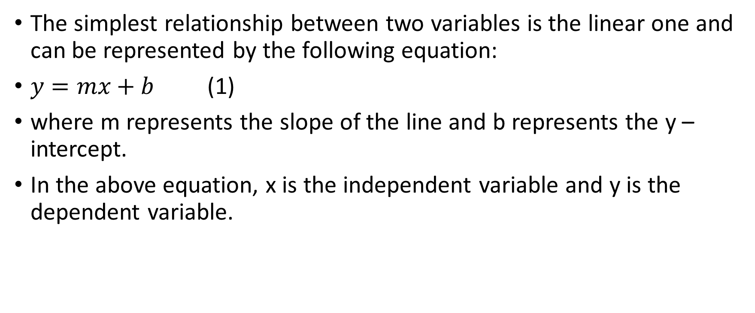
The linear relationship between 2 variables
The simplest relationship between two variables is the linear one and can be represented by the following equation:
$y=mx+b$ (1)
where m represents the slope of the line and b represents the y – intercept.
In the above equation, x is the independent variable and y is the dependent variable.

Slide 3
The slope, m, indicates how steep the line will look when drawn on a Cartesian plane; when m = 0, the line will be horizontal, meaning y will have only one value for any values of x. For vertical lines, the slope is not defined.
The y – intercept represents the value of y for which x = 0, or, in other words, the point where the line intersects the y axis.

Slide 4
In most real situations, the points representing the data are not exactly on the line, but tend to cluster around the line.
In these situations, finding the line that is the closest approximation of the data will help us predict the approximate values of the dependent variable for a certain value of the independent variable.

Slide 5
Example. Given the data below, construct a scatter plot graph to represent the data
(1.2,1), (1.3,1.6), (1.7,2.7), (2,2), (3,1.8), (3,3), (3.8,3.3), (4,4.2).
The first step in finding the line of best fit is to draw the scatter plot representing the data.

Slide 6
If we draw a line, not the best line, necessarily, but a line, as shown, we can begin to consider how well it fits the data. From each data point, we construct a vertical line segment to the line. This distance gives us an indication of the error, the difference between the predicted and actual y values.
Squaring this error, which may be positive or negative, gives all positive values, an advantage in finding a total. The sum of the squares gives us a measure of the scatter of data away from the line.

Slide 7
We try drawing another line, this time a horizontal line is shown. The squares are still fairly large.

Slide 8
This line seems like a better fit. It has a positive slope and an intercept that seems reasonable. The total sum of the squares is less than that for the two previous lines.

Slide 9
Finding the line of best fit
x | y
1 | 2
2 | 4
3 | 4
4 | 6
Step 1. Draw the scatter diagram representing the data.
The scatter diagram is a diagram where the points of coordinates (x, y) are drawn without being connected to each other as shown below.

Slide 10
The scatter plot (Step 1)

Slide 11
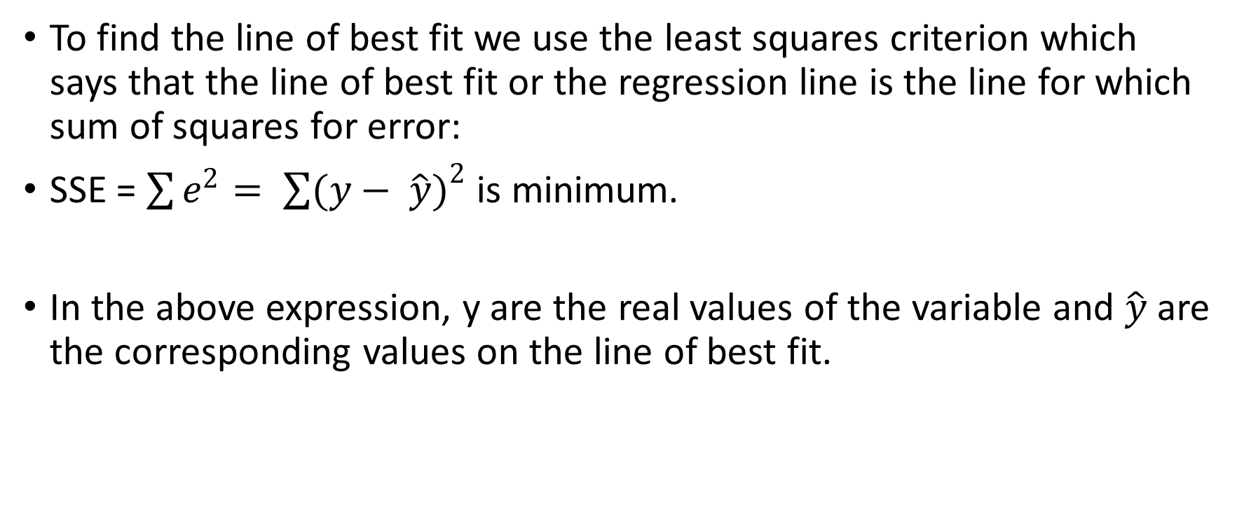
As discussed before…
To find the line of best fit we use the least squares criterion which says that the line of best fit or the regression line is the line for which sum of squares for error:
SSE = $\sum{e^{2}= \sum{{(y− \hat{y})}^{2}}}$ is minimum.
In the above expression, y are the real values of the variable and $\hat{y}$ are the corresponding values on the line of best fit.

Slide 12
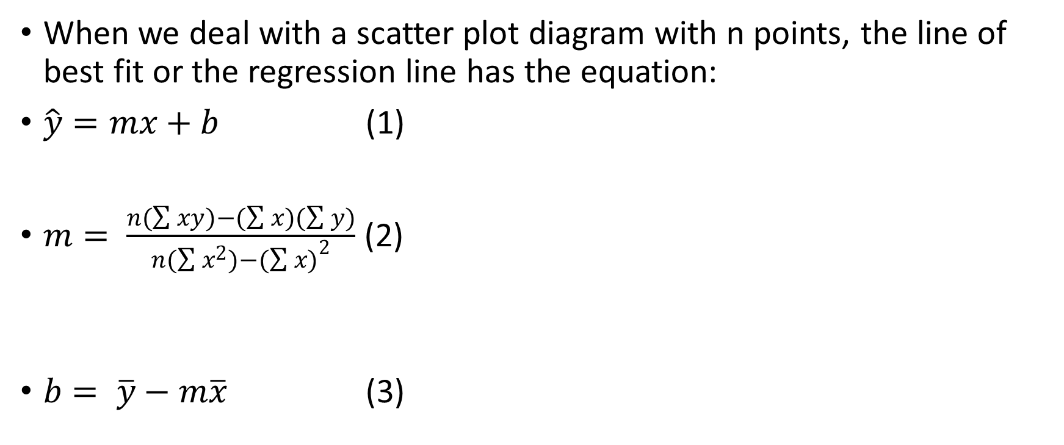
When we deal with a scatter plot diagram with n points, the line of best fit or the regression line has the equation:
$\hat{y}=mx+b$ (1)
$m= \frac{n(\sum{xy)−(\sum{x)(\sum{y)}}}}{n(\sum{x^{2})−{(\sum{x)}}^{2}}}$ (2)
$b= \overline{y}−m\overline{x}$ (3)

Slide 13
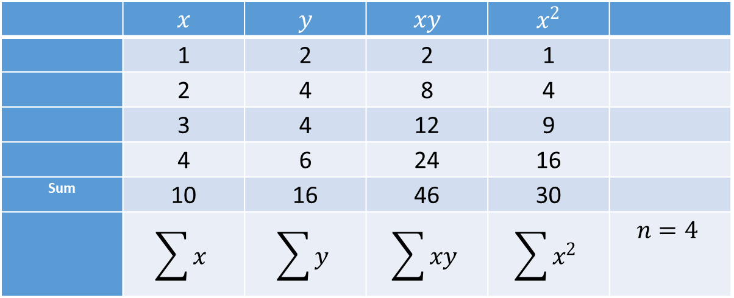
Step 2. Organize the calculations into the following table:
 | $$x$$ | $$y$$ | $$xy$$ | $$x^{2}$$
 | 1 | 2 | 2 | 1
 | 2 | 4 | 8 | 4
 | 3 | 4 | 12 | 9
 | 4 | 6 | 24 | 16
Sum | 10 | 16 | 46 | 30
 | $$\sum{x}$$ | $$\sum{y}$$ | $$\sum{xy}$$ | $$\sum{x^{2}}$$ | $$n=4$$

Slide 14
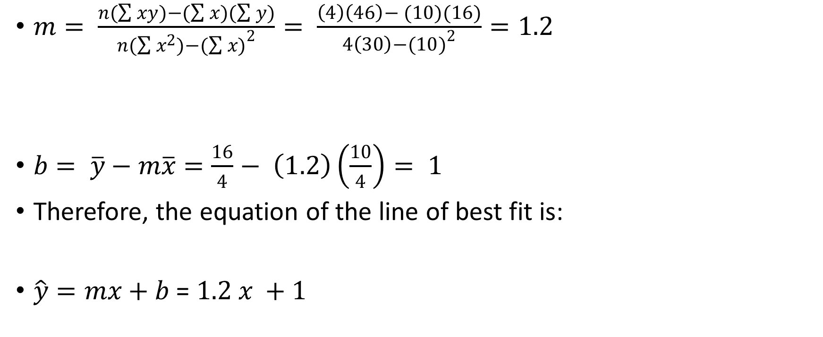
Step 3. Using the values from the table, find the slope m and the y – intercept b and write the equation of the line of best fit.
$m= \frac{n(\sum{xy)−(\sum{x)(\sum{y)}}}}{n(\sum{x^{2})−{(\sum{x)}}^{2}}}= \frac{\left(4\right)\left(46\right)− (10)(16)}{4\left(30\right)−{(10)}^{2}}=1.2$
$b= \overline{y}−m\overline{x}=\frac{16}{4}− \left(1.2\right)\left(\frac{10}{4}\right)= 1$
Therefore, the equation of the line of best fit is:
$\hat{y}=mx+b$ = $1.2 x +1$

Slide 15
Step 4. Sketch the line of best fit by using the coordinates of two chosen points.
For instance, we can choose x = 2 and y =3.4 and x=3, y = 4.6.
Mark the points on the scatter plot graph and connect them using a ruler.
The line of best fit will look like in the diagram below:
From this diagram, we can approximate values of y for any given x. For instance, when x=1.8, y will have the value of y = 3.2.

Slide 16
Appropriateness of linear regression
In this scatter plot, x and y have a positive correlation, which means that the points can be approximated by a line with a positive slope.

Slide 17
In this scatter plot, x and y have a negative correlation, which means that the points can be approximated by a line with a negative slope.

Slide 18
In this scatter plot, x and y have relatively no correlation, which means that the points cannot be approximated by a line.

Slide 19
The Linear Correlation Coefficient
The regression line is a useful tool when the points on the scatter diagram show some sort of a linear tendency, meaning they are clustering about a non-horizontal line.
The closer the points are to the regression line, the stronger the degree of linearity.
We define the linear correlation coefficient as being the number r that measures the degree of linearity between x and y. The linear correlation coefficient is used to determine if there is some degree of linearity, so that we know if finding the regression line would be useful.

Slide 20
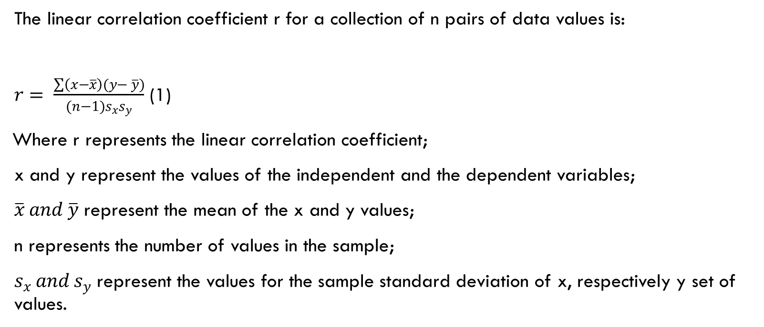
Definition
The linear correlation coefficient r for a collection of n pairs of data values is:
$r= \frac{\sum{\left(x−\overline{x}\right)(y− \overline{y})}}{(n−1)s_{x}s_{y}}$ (1)
Where r represents the linear correlation coefficient;
x and y represent the values of the independent and the dependent variables;
$\overline{x} and \overline{y}$ represent the mean of the x and y values;
n represents the number of values in the sample;
$s_{x }and s_{y}$ represent the values for the sample standard deviation of x, respectively y set of values.

Slide 21

An alternative formula for r is:
$r= \frac{n(\sum{xy)−(\sum{x)(\sum{y)}}}}{\sqrt{n(\sum{x^{2})−{(\sum{x})}^{2}}}×\sqrt{n(\sum{y^{2})−{(\sum{y})}^{2}}}}$ (2)

Slide 22
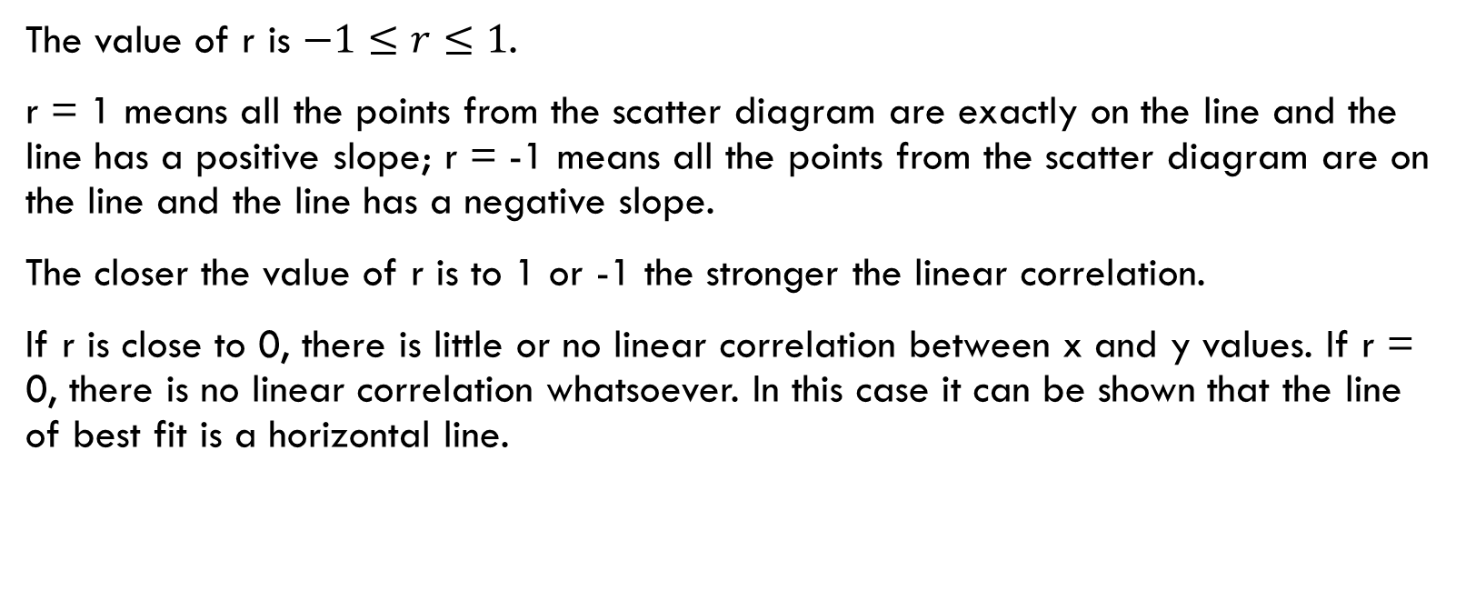
Properties of the coefficient of correlation
The value of r is $−1≤r≤1$.
r = 1 means all the points from the scatter diagram are exactly on the line and the line has a positive slope; r = -1 means all the points from the scatter diagram are on the line and the line has a negative slope.
The closer the value of r is to 1 or -1 the stronger the linear correlation.
If r is close to 0, there is little or no linear correlation between x and y values. If r = 0, there is no linear correlation whatsoever. In this case it can be shown that the line of best fit is a horizontal line.

Slide 23
Interpretation
When we say that there is no linear correlation between x and y, that does not mean there is no other type of correlation between them (i.e. quadratic, exponential, etc.).
The important idea is that the closer r is to 0, the weaker the linear correlation is; this also means that finding the regression line will not be helpful in predicting the y values (will not provide accurate enough prediction values for y).

Slide 24
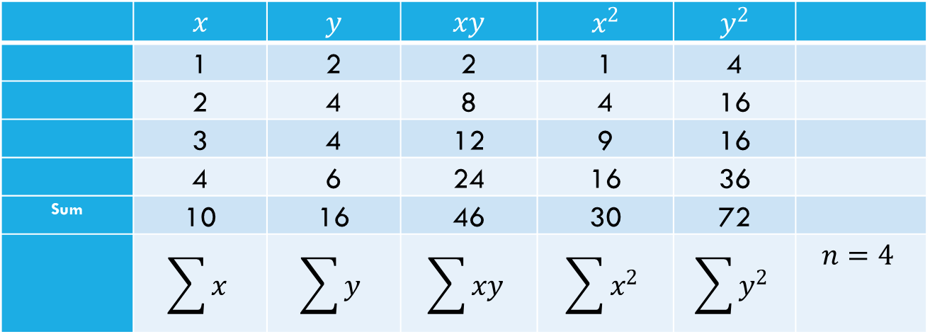
Example. Find the coefficient of correlation for the line of best fit from the previous example
Step 1. Organize the calculations in the following table.
 | $$x$$ | $$y$$ | $$xy$$ | $$x^{2}$$ | $$y^{2}$$
 | 1 | 2 | 2 | 1 | 4
 | 2 | 4 | 8 | 4 | 16
 | 3 | 4 | 12 | 9 | 16
 | 4 | 6 | 24 | 16 | 36
Sum | 10 | 16 | 46 | 30 | 72
 | $$\sum{x}$$ | $$\sum{y}$$ | $$\sum{xy}$$ | $$\sum{x^{2}}$$ | $$\sum{y^{2}}$$ | $$n=4$$

Slide 25

Step 2. Use the formula for the linear correlation coefficient
$r= \frac{n(\sum{xy)−(\sum{x)(\sum{y)}}}}{\sqrt{n(\sum{x^{2})−{\left(\sum{x}\right)}^{2}}}×\sqrt{n(\sum{y^{2})−{\left(\sum{y}\right)}^{2}}}}$
$\frac{\left(4\right)\left(46\right)− \left(10\right)(16)}{\sqrt{\left(4\right)\left(30\right)− {10}^{2}}×\sqrt{\left(4\right)\left(72\right)− {16}^{2}}}= \frac{24}{\sqrt{20}\sqrt{32}}=0.9486833 ≅0.95$

Slide 26
Step 3. Interpret the results
For this value of r we can conclude that there is a strong linear correlation between the x and the y values in the set of data.
When r is calculated, we can say that for r = 0.95 we have a pretty strong linear relationship; nonetheless, if r has a value of 0.70, it is hard to decide if the linearity of the relationship is strong enough. This question led to the introduction of a new coefficient called the coefficient of determination.
The coefficient of determination is used to interpret the degree of linearity in more familiar terms.

Slide 27
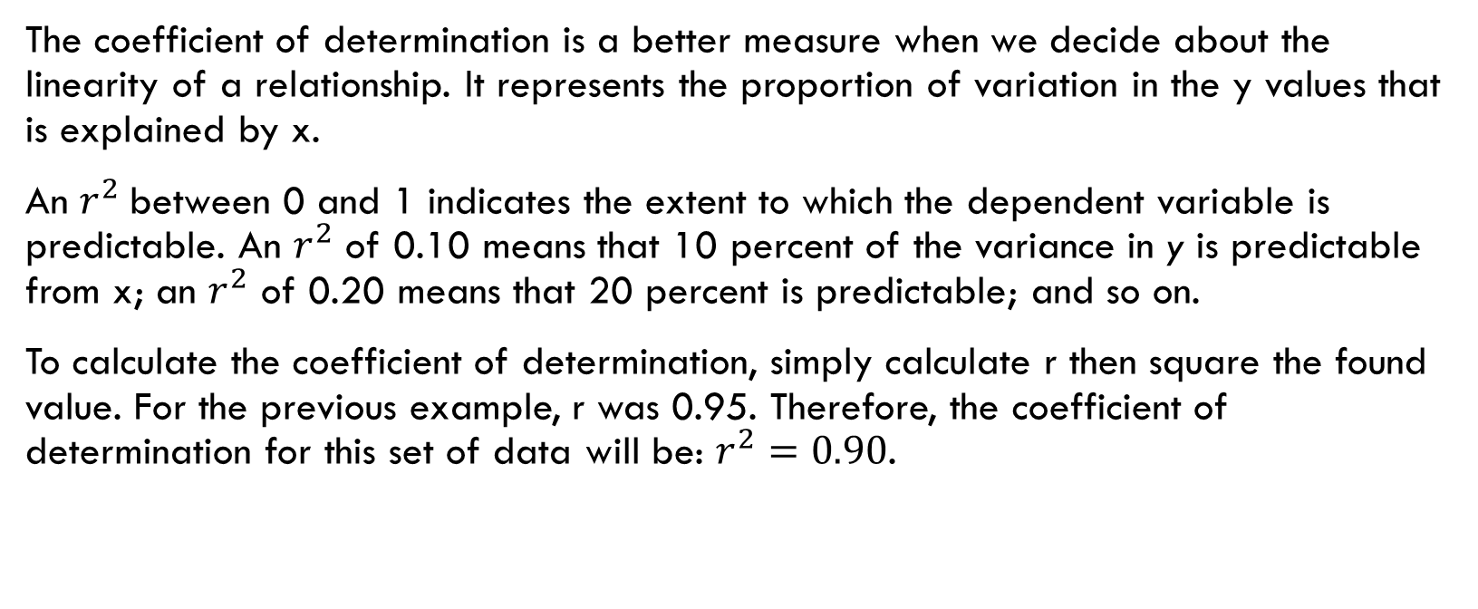
Coefficient of determination continued…
The coefficient of determination is a better measure when we decide about the linearity of a relationship. It represents the proportion of variation in the y values that is explained by x.
An $r^{2}$between 0 and 1 indicates the extent to which the dependent variable is predictable. An $r^{2}$ of 0.10 means that 10 percent of the variance in y is predictable from x; an $r^{2}$ of 0.20 means that 20 percent is predictable; and so on.
To calculate the coefficient of determination, simply calculate r then square the found value. For the previous example, r was 0.95. Therefore, the coefficient of determination for this set of data will be: $r^{2}=0.90$.

Slide 29
Practice
1. A town assessor was trying to determine the relationship between the size of a parcel of land (x) and the selling price (y).
Size in acres (x) | Selling price in thousands of dollars (y)
0.5 | 25
1.0 | 40
1.5 | 55
2.0 | 65
2.5 | 75
3.0 | 80

Slide 30
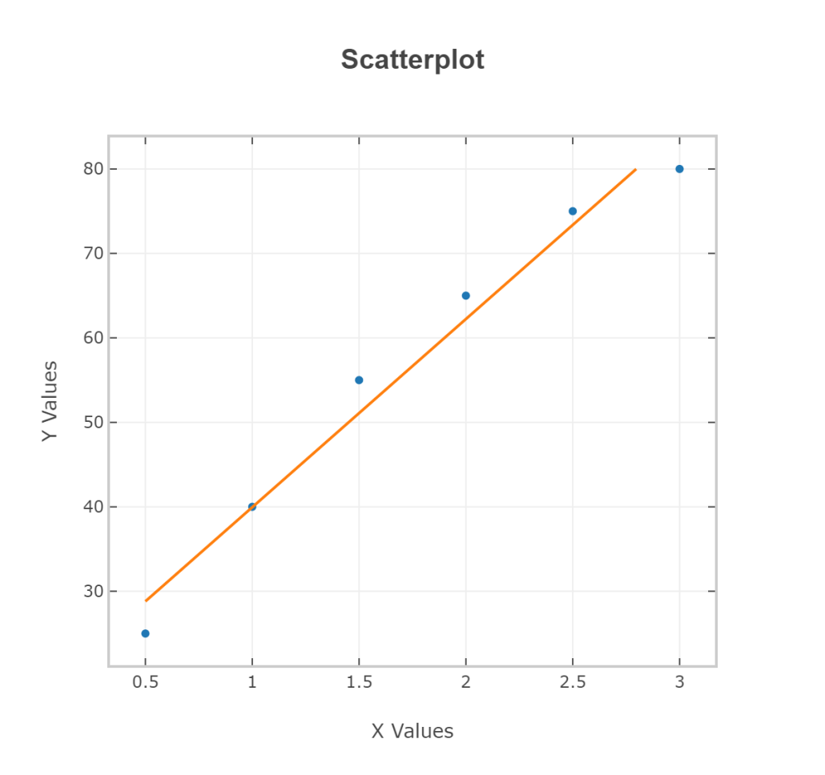
a) Draw a scatter diagram. Does the selling price appear to increase as the acreage increases?

Slide 31
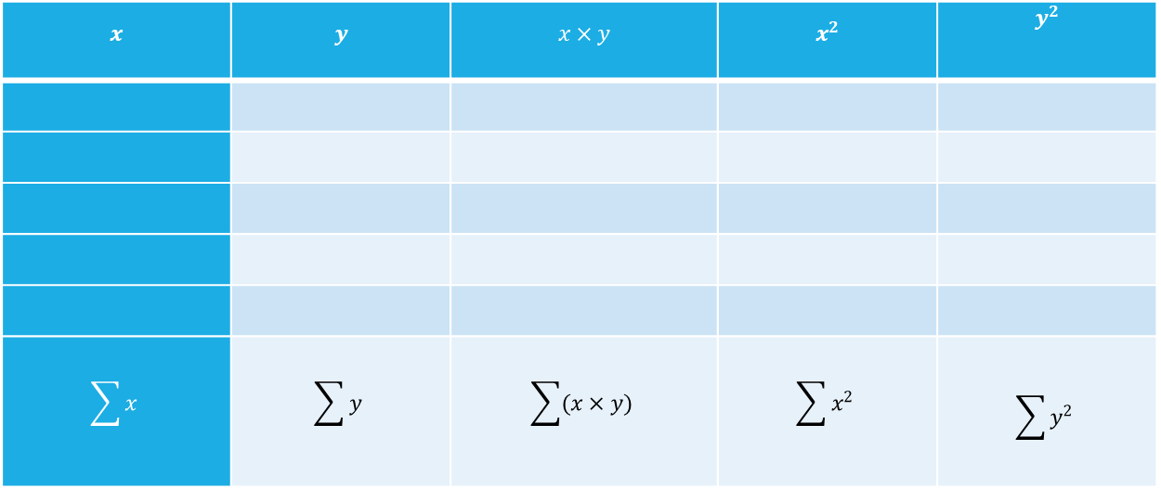
b) Find the line of best fit. Sketch the line on the same diagram as the scatter plot one.
$$x$$ | $$y$$ | $$x×y$$ | $$x^{2}$$ | $$y^{2}$$
$$\sum{x}$$ | $$\sum{y}$$ | $$\sum{(x×y)}$$ | $$\sum{x^{2}}$$ | $$\sum{y^{2}}$$

Slide 33
c) Estimate the selling price for a 1.7 –acre piece of land.

Slide 34
d) Calculate the linear correlation coefficient

Slide 35
e) Find the coefficient of determination. f) Draw a conclusion about the linearity of the data.

